Slide 1
Object Oriented Programming Lab CSE 1206
Lab 4

Slide 2
Course Teacher Dr. Shahriar Mahbub, Associate Professor Nowshin Nawar Arony, Adjunct Lecturer

Slide 3
Type Casting
When two types are incompatible and destination type is smaller than source type, we do type casting to convert them.
(target-type) value
Example:
double dbNum = 5.8;
int num = (int)dbNum;

Slide 4



RED Tulip
White Tulip
Pink Tulip
Object 1
Object 2
New Object

Slide 5
Project Name: CreateTulip
Another Class name: Tulip
Variables in Tulip class:
private String color;
private double height;
Declare a default empty constructor, parameterized constructor and respective getter setter methods in Tulip class.
Create two objects of Tulip in CreateTulip and initialize the variables using the parameterized constructor.

Slide 6
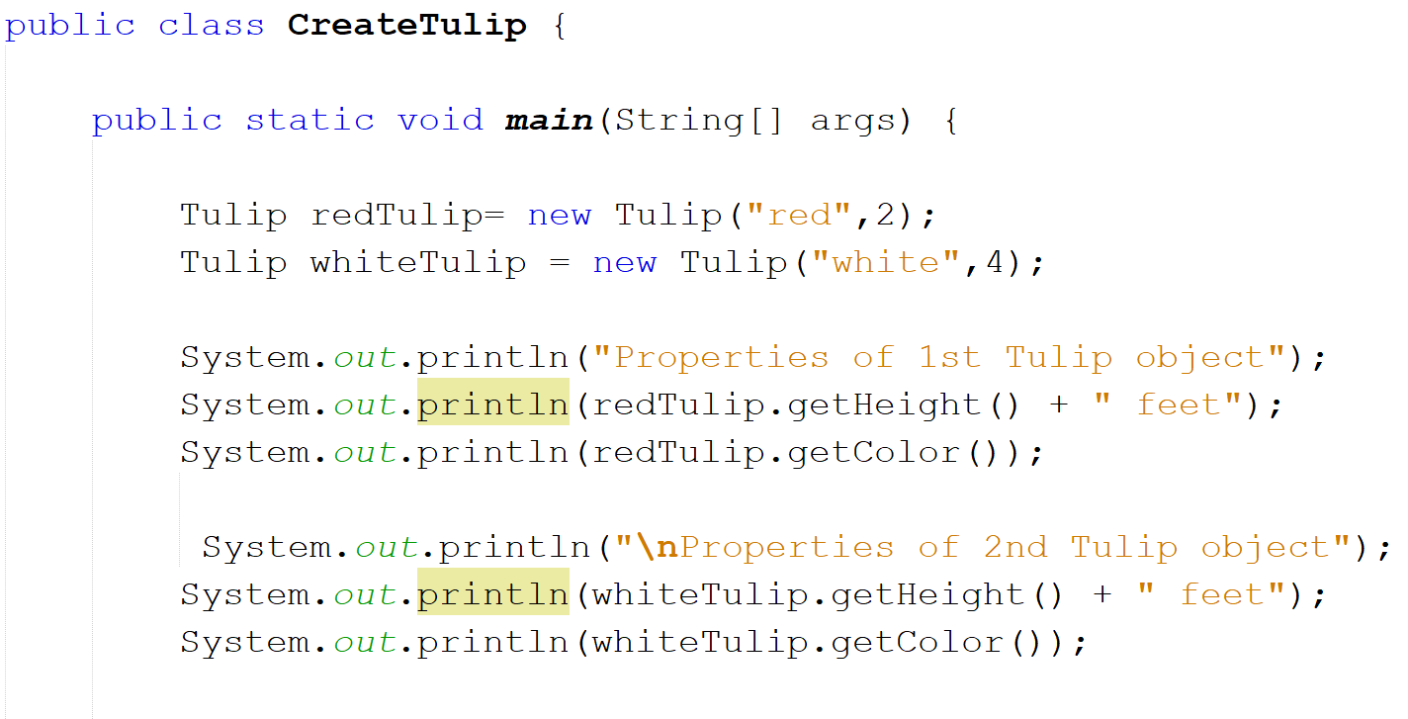

Slide 7
RED Tulip
White Tulip
Object 1
Object 2

Slide 8
Objects As Return Types and Parameters in Methods

Slide 9
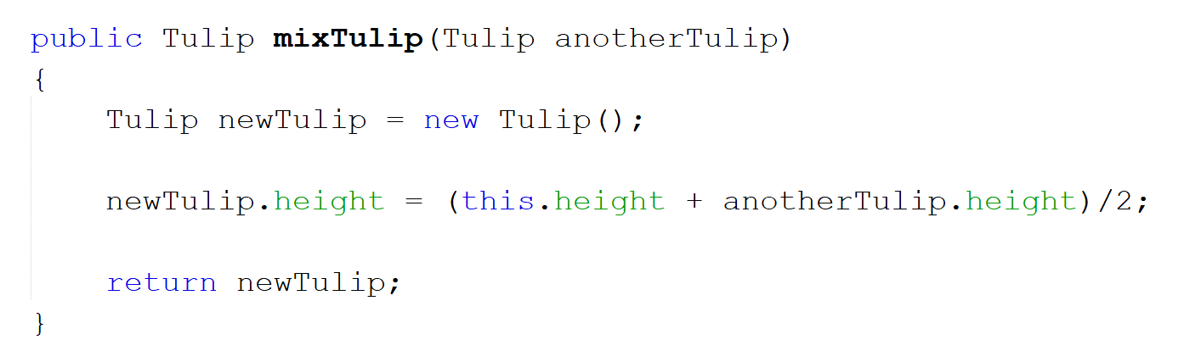
Create this method inside the class Tulip

Slide 10
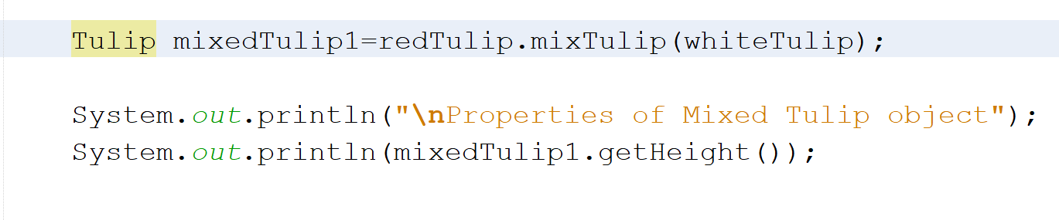
Call the method in the CreateTulip class

Slide 11
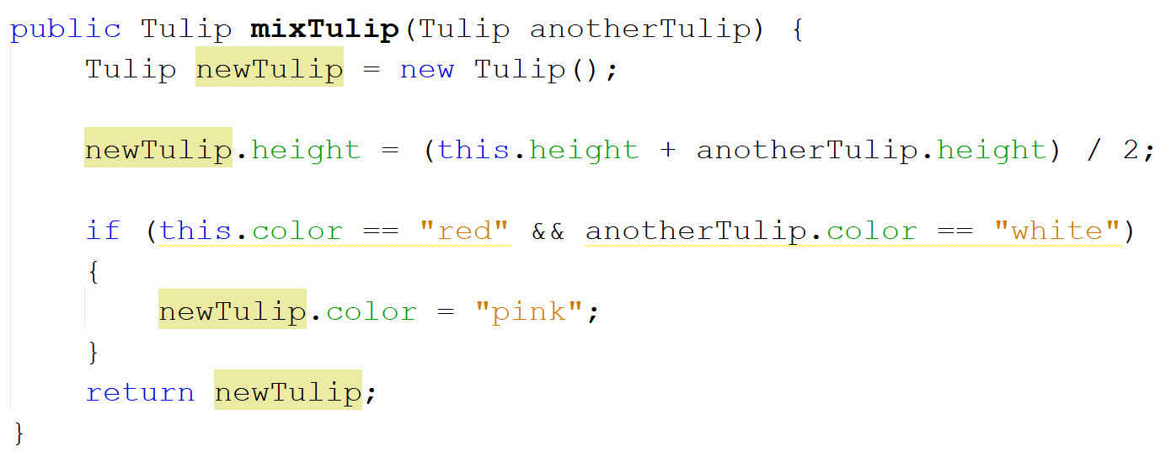
Lets complete the method by changing the color also.

Slide 12

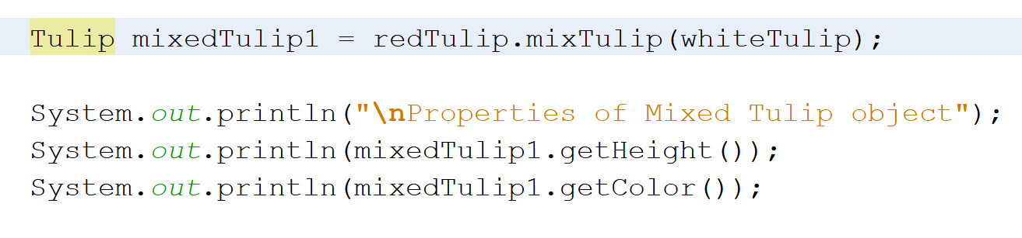
Print the color in the CreateTulip class

Slide 13
Method Overloading
Java allows different methods to have same name.
Conditions:
By changing number of arguments.
By changing the data type of arguments.
Now Create a new Project Named MethodOverloading.
Inside this Project Create a new Class Named Adder.

Slide 14
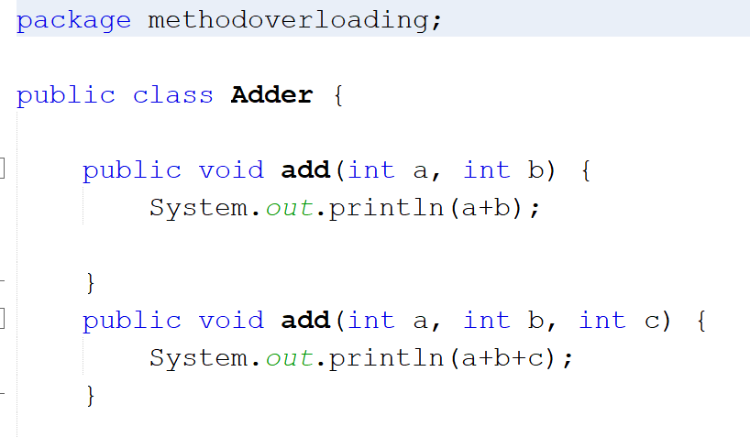
Two methods having same name add but number of arguments in the parameter are different

Slide 15
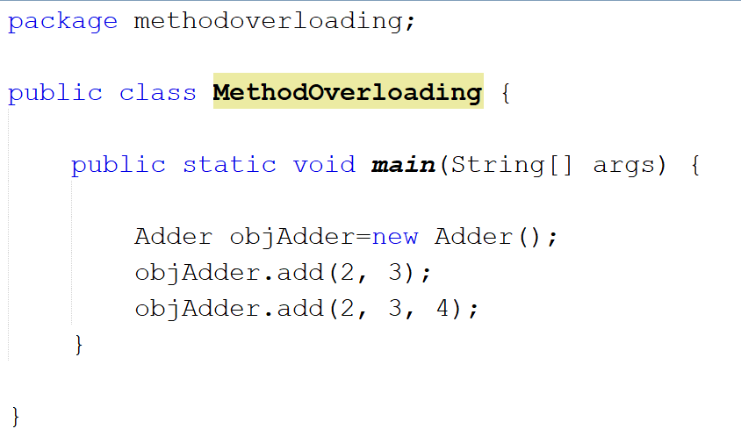

Slide 16
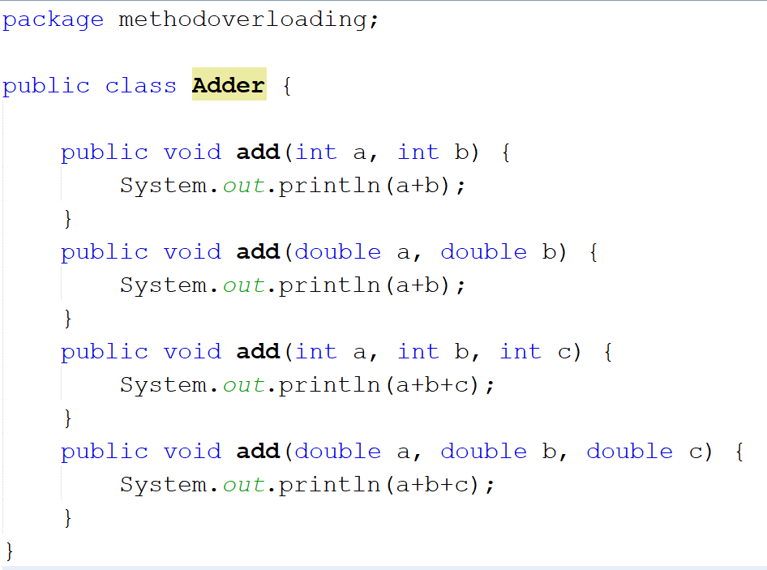
Methods having same name add and same number of arguments but type is different

Slide 17
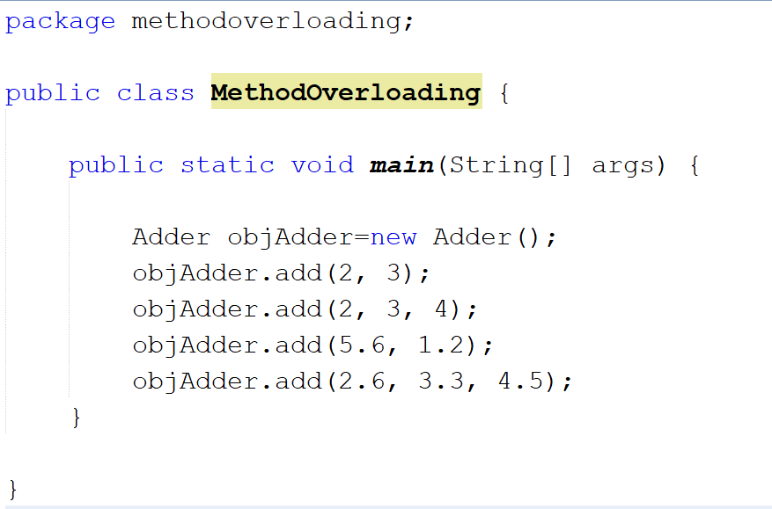

Slide 18
Changing the return type is not counted as method overloading

Slide 19
Going back to Tulip class
What if we want to mix 3 different colored tulips?
Then we can pass two objects of Tulip class in the parameter.
For that lets create another method.

Slide 20
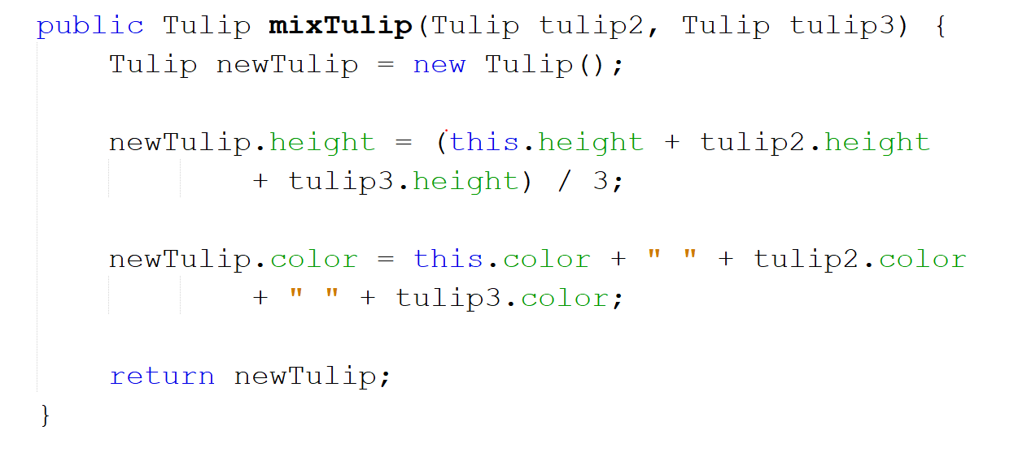

Slide 21
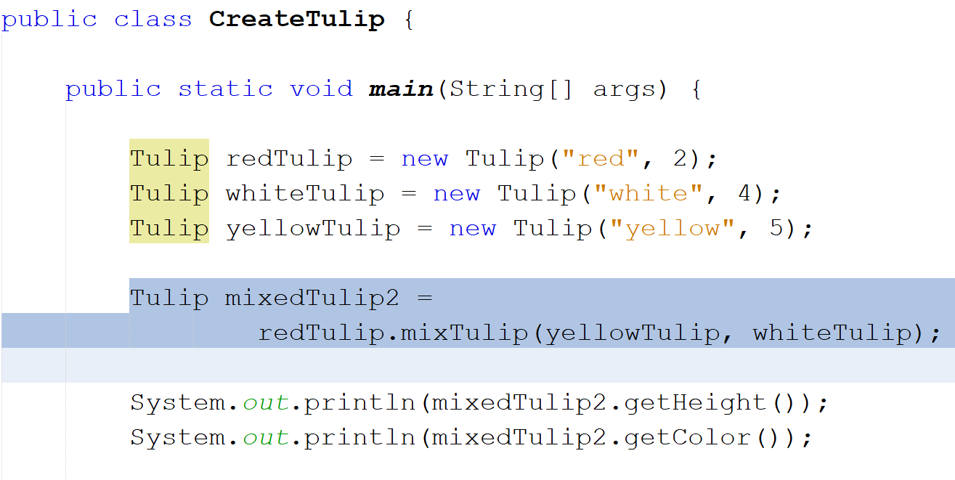

Slide 22
Type Promotion Rules
When two types are compatible and destination type is larger than source type.
byte -> short || int || long || float || double
short -> int || long || float || double
char -> int || long || float || double
int -> long || float ||double
long -> float || double
float -> double
*Read Type Conversion and Casting in Chapter 3 from the book Java The Complete Reference by Herbert Schildt.
(Page 48 to 51 in eight edition)

Slide 23
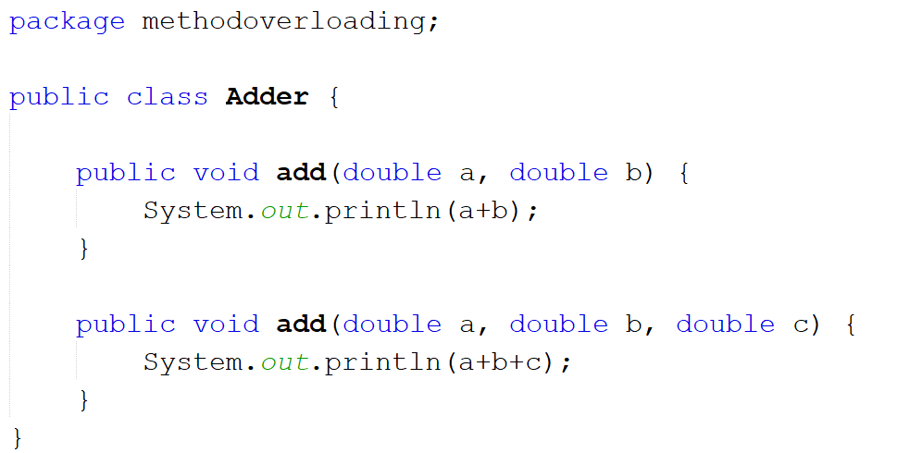

Slide 24
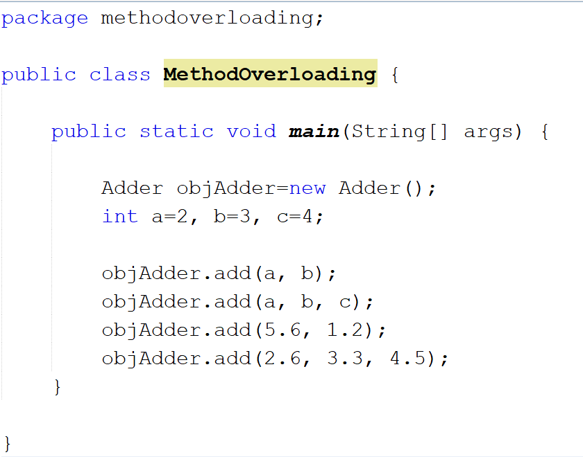
Although Integers but Java automatically converts them to double

